Slide 1

LIVING OFF THE CRASH
Weaponizing System-Generated Crash Dumps

Slide 2





Offensive Security & Incident Response
ABOUT ME
Prior consulting & MSP background focusing on systems and network engineering
Louisiana State University & the SANS Technology Institute
Jason Mull
Senior Cybersecurity Architect
Lockstep Technology Group
Based in Baton Rouge, Louisiana

Slide 3




AGENDA
Crash Dump Crash Course
Where’s the Value Here?
Weaponizing Crash Dumps
Detection & Remediation Options

Slide 4
Crash Dump Crash Course

Slide 5

CRASH DUMP TYPES
Complete
Active
Automatic

Slide 6
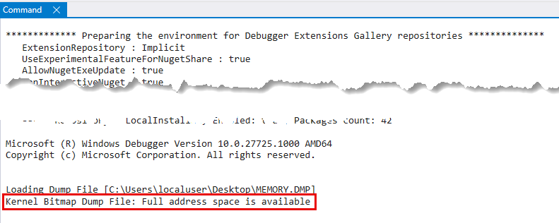
IDENTIFICATION

Slide 7
IDENTIFICATION
Crash Dump Type | Description
Complete | Kernel Bitmap Dump File: Full address space is available.
Active Memory | Kernel Bitmap Dump File: Active memory is available.
Automatic | Kernel Bitmap Dump File: Kernel address space is available. User address space may not be available

Slide 8
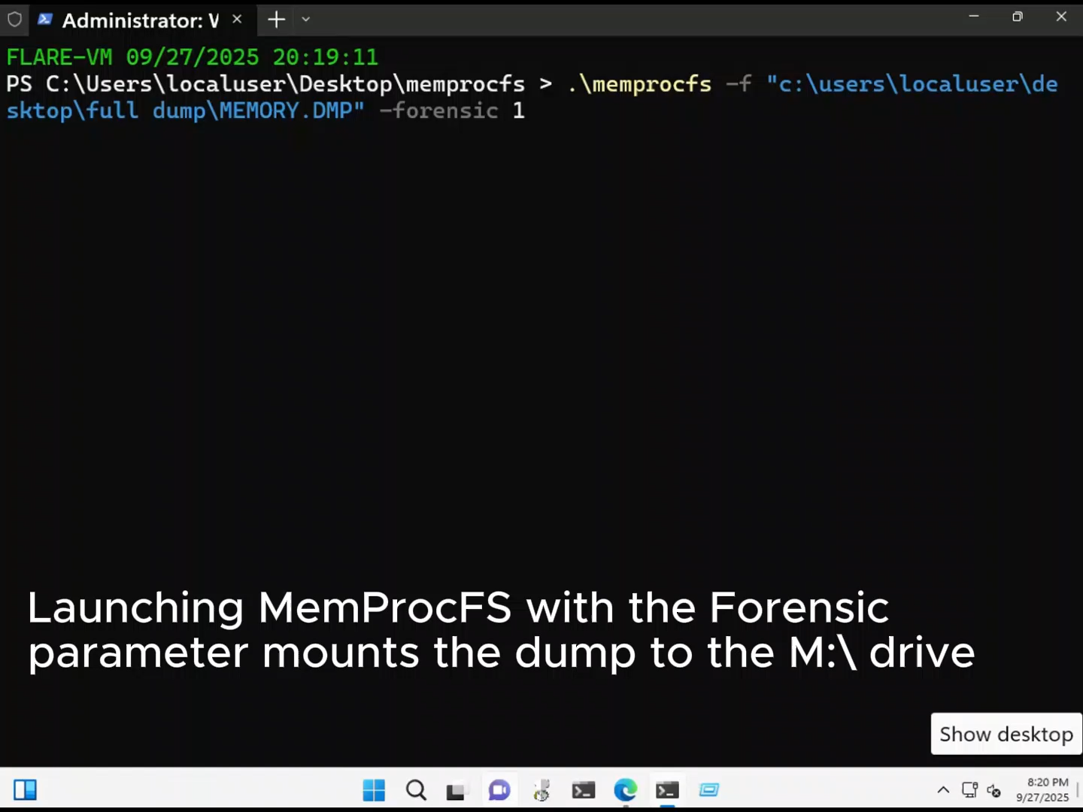

Slide 9
Where’s the Value Here?

Slide 10
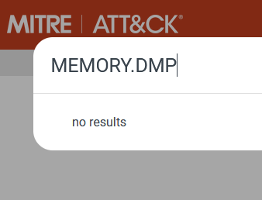
ATT&CK VISIBILITY
ATT&CK visibility appears light
Nothing referencing MEMORY.DMP files
Crash dump references are mostly related to Cisco ArcaneDoor exploit

Slide 11
Initial Access
Discovery
Exfiltration
Offline Analysis
Privilege Escalation
ATTACK SCENARIO

Slide 12
Weaponizing Crash Dumps

Slide 13
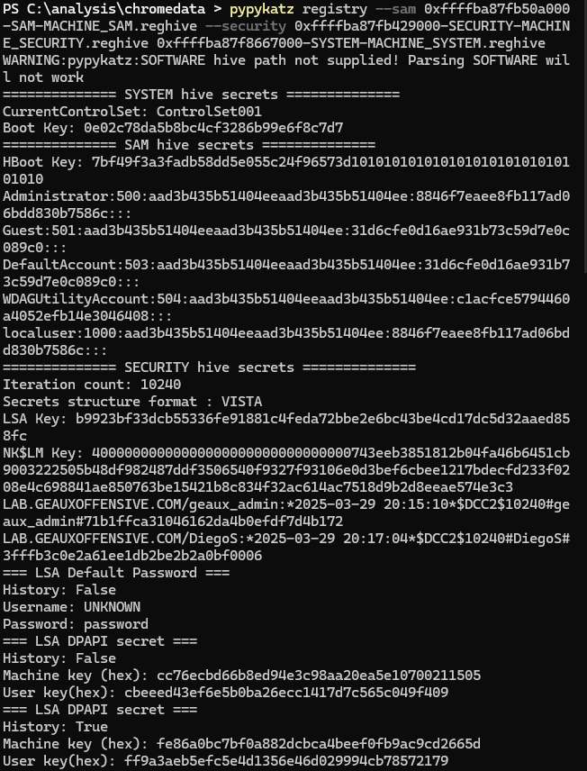
SYSTEM CREDENTIALS
AD and local credentials can be obtained through the registry hives found in memory
Pypykatz is great for this
The contents of registry hive files were inconsistent outside of Complete Memory Dumps

Slide 14
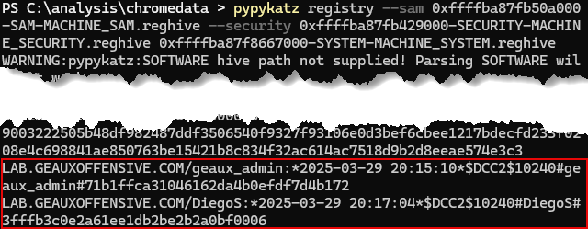
SYSTEM CREDENTIALS

Slide 15
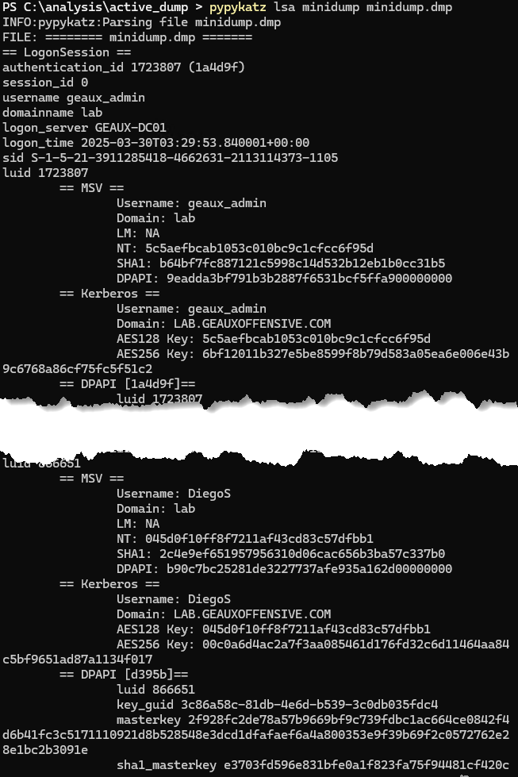
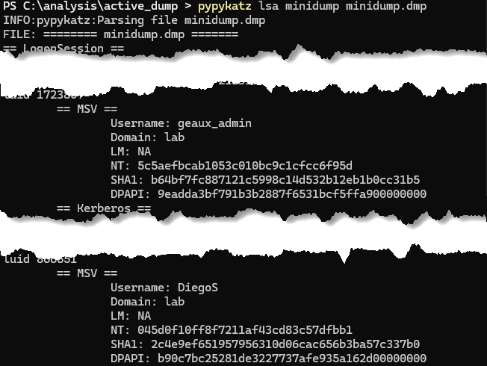
SYSTEM CREDENTIALS
Dumping LSASS.exe is well detected at this point
What if you could get that process somewhere else?
Accessible in Active Memory Dumps, too
MemProcFS won’t do this by default, though there are alternative builds

Slide 16
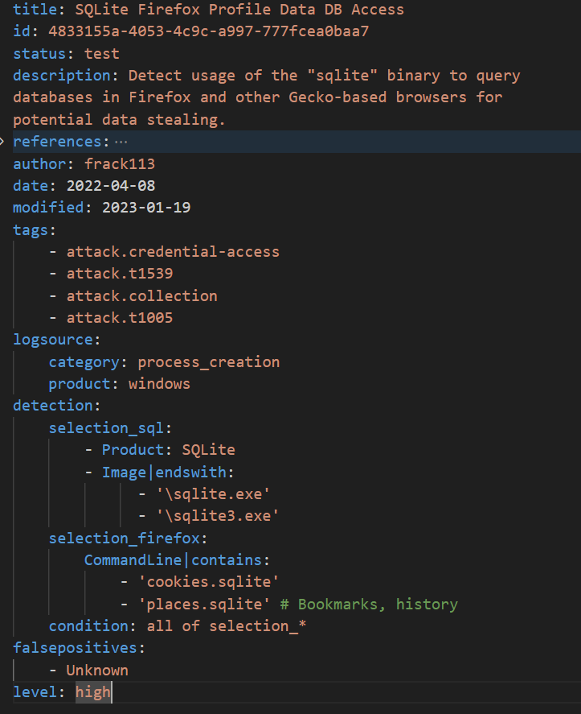
WEB BROWSERS
Web browsers store information like cookies and credentials
Recognized by ATT&CK as well
T1539 – Session Cookie Theft
T1555.003 – Credentials from Web Browsers

Slide 17
FIREFOX SECRETS
Firefox stores cookies and other sensitive info in an unencrypted SQLite DB
Sigma contains detections for interaction with these databases
Crash dump analysis gives us a stealthier method to interact with these files

Slide 18
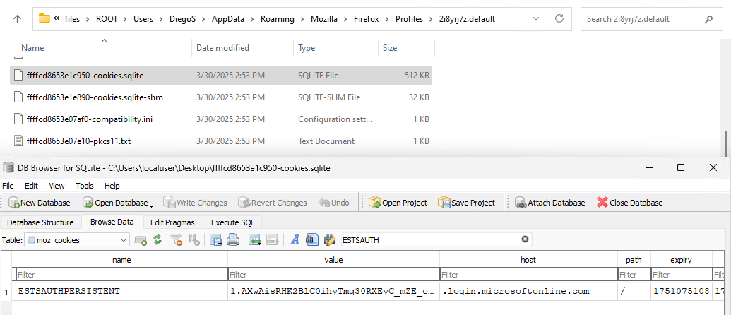
FIREFOX SECRETS

Slide 19
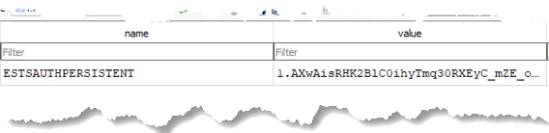
FIREFOX SECRETS

Slide 20
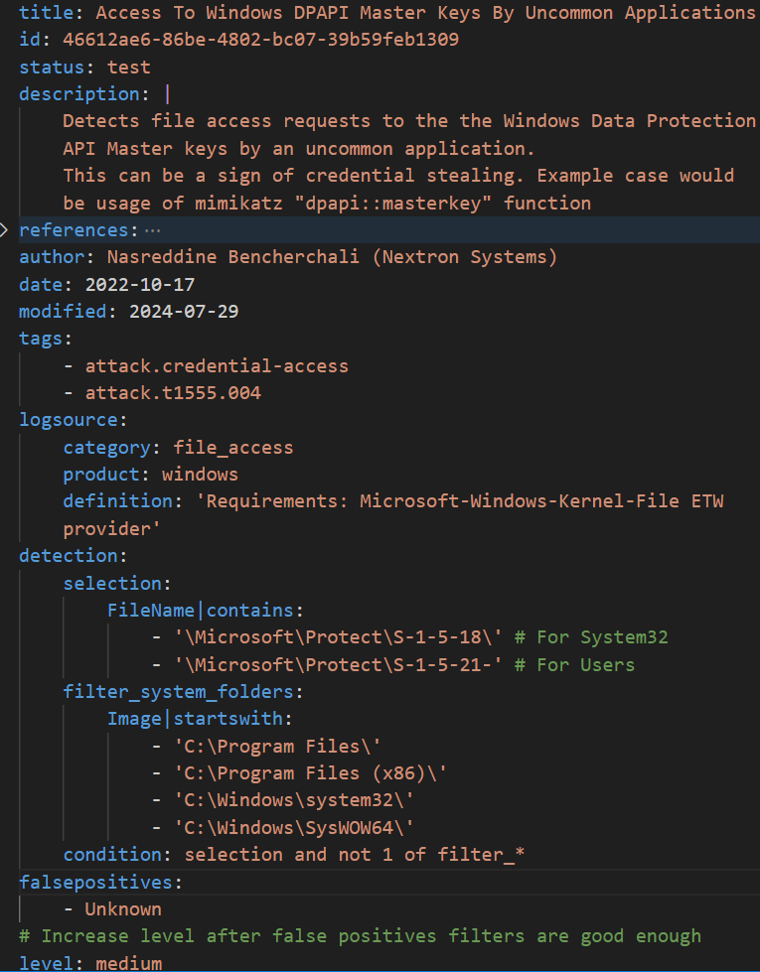
DPAPI
Windows-native encryption API
Master keys stored per user or computer
What does it protect?
Windows Vault Secrets
Chrome Sensitive Data
Many more…

Slide 21
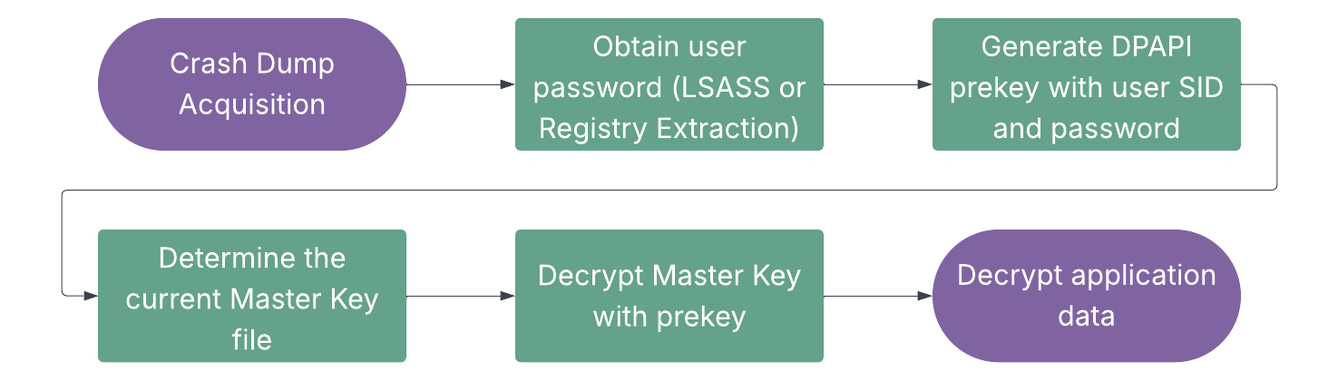
DPAPI EXTRACTION PROCESS
DPAPI Master Key Location
C:\users\<user>\appdata\roaming\microsoft\protect\<SID>

Slide 22
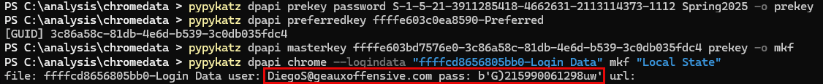
DPAPI EXTRACTION - APPLIED
Chrome Artifact Paths
%LocalAppData%\Google\Chrome\User Data\Default\Login Data
%LocalAppData%\Google\Chrome\User Data\Local State
This procedure isn’t new: The difference is extracting this data from crash dumps to lessen detection chances

Slide 23
DPAPI BEYOND
Target | What You Get | Attack Value
RDP Credentials | Remote Desktop passwords | Lateral movement
WiFi Passwords | Wireless PSKs | Physical network access
Windows Vault | VPN, shares, web passwords | Varied credential access
PowerShell Secure Strings | Automation credentials | Script-embedded secrets

Slide 24
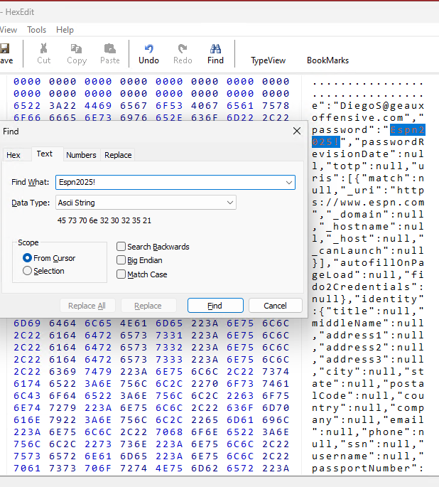
PASSWORD MANAGERS
An interesting attack vector, depending on the timing of the crash
Vault passwords unencrypted in memory when the vault is unlocked
What about the master passwords, though?

Slide 25
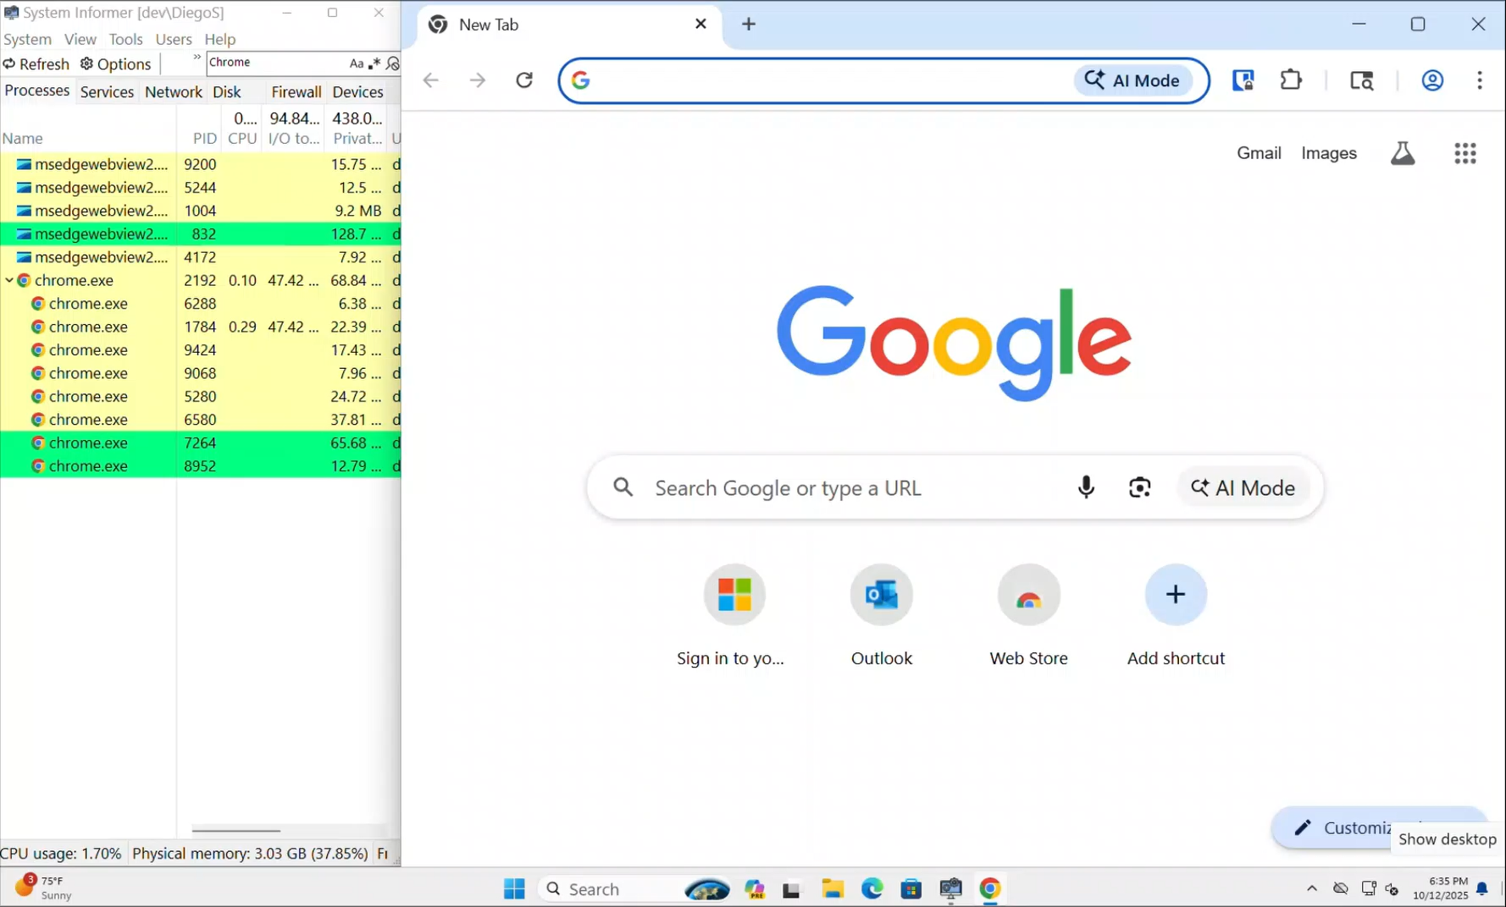

Slide 26
Detection & Remediation Options

Slide 27
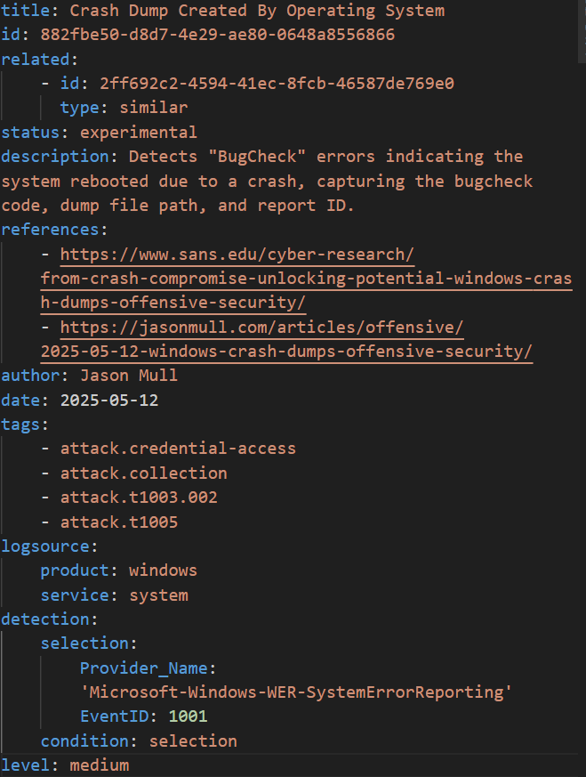
EVENT LOGS
System Event ID 1001 records crash dump creations, if enabled
Sigma rules can be used to search for this ID at scale using tools like Chainsaw
GitHub – Crash Dump Created by Operating System

Slide 28
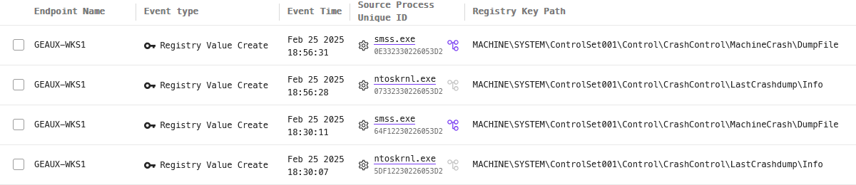
EDR ACTIVITY
event.type = "Registry Value Create"
AND (
registry.keyPath CONTAINS ANYCASE "\\Control\\CrashControl\\LastCrashdump\\Info"
OR
registry.keyPath CONTAINS ANYCASE "\\Control\\CrashControl\\MachineCrash\\DumpFile"
)

Slide 29
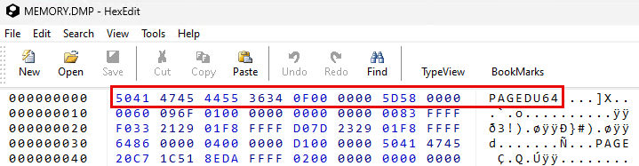
FILE SIGNATURES
Defenders can search for crash dump files on an endpoint using PowerShell
PowerShell can search for file headers, rather than specific file names and paths

Slide 30
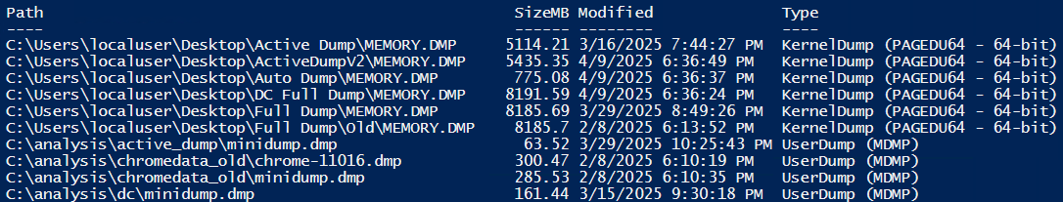
FILE SIGNATURES
Script output provides a clean list of crash dump path, size, and type
Currently runs per endpoint, but can be modified to connect to remote endpoints or be deployed through remote management solutions

Slide 31
TAKEAWAYS

Slide 32
TAKEAWAYS
Crash dumps: Do we really need to automatically generate them?
There’s a lot of potential for valuable information, but timing, and a little bit of luck, is frequently needed
Many of these examples required larger dump formats, though these are not the default
More data types are out there within all crash dump types, finding them just requires a bit of curiosity

Slide 33



CONTACT
https://jasonmull.com
https://www.linkedin.com/in/jasonmull
https://bit.ly/OffensiveCrashDumps

Slide 34
REFERENCES
From Crash to Compromise: Unlocking the Potential of Windows Crash Dumps in Offensive Security | SANS Institute
Understanding Crash Dump Files | Microsoft Community Hub
GitHub - ufrisk/MemProcFS: MemProcFS
GitHub - skelsec/pypykatz: Mimikatz implementation in pure Python
GitHub - 0xNemo/MemProcFS_lsass: Fork MemProcFS pour faire un mini dump de lsass
sigma/rules/windows/process_creation/proc_creation_win_sqlite_firefox_gecko_profile_data.yml at master · SigmaHQ/sigma · GitHub
Steal Web Session Cookie, Technique T1539 - Enterprise | MITRE ATT&CK®
Credentials from Password Stores: Credentials from Web Browsers, Sub-technique T1555.003 - Enterprise | MITRE ATT&CK®
Recovering Windows Secrets and EFS Certificates Offline

